Slide 1
WEEK 7 · LECTURE 13
Building a Support Copilot
Part 1: the layer that reads
5,000 tickets a week, three support reps, and nothing in the queue has ever been sorted. Let's ship anyway.
ISBA 2411 · Natural Language Processing & AI · Summer 2026

Slide 2
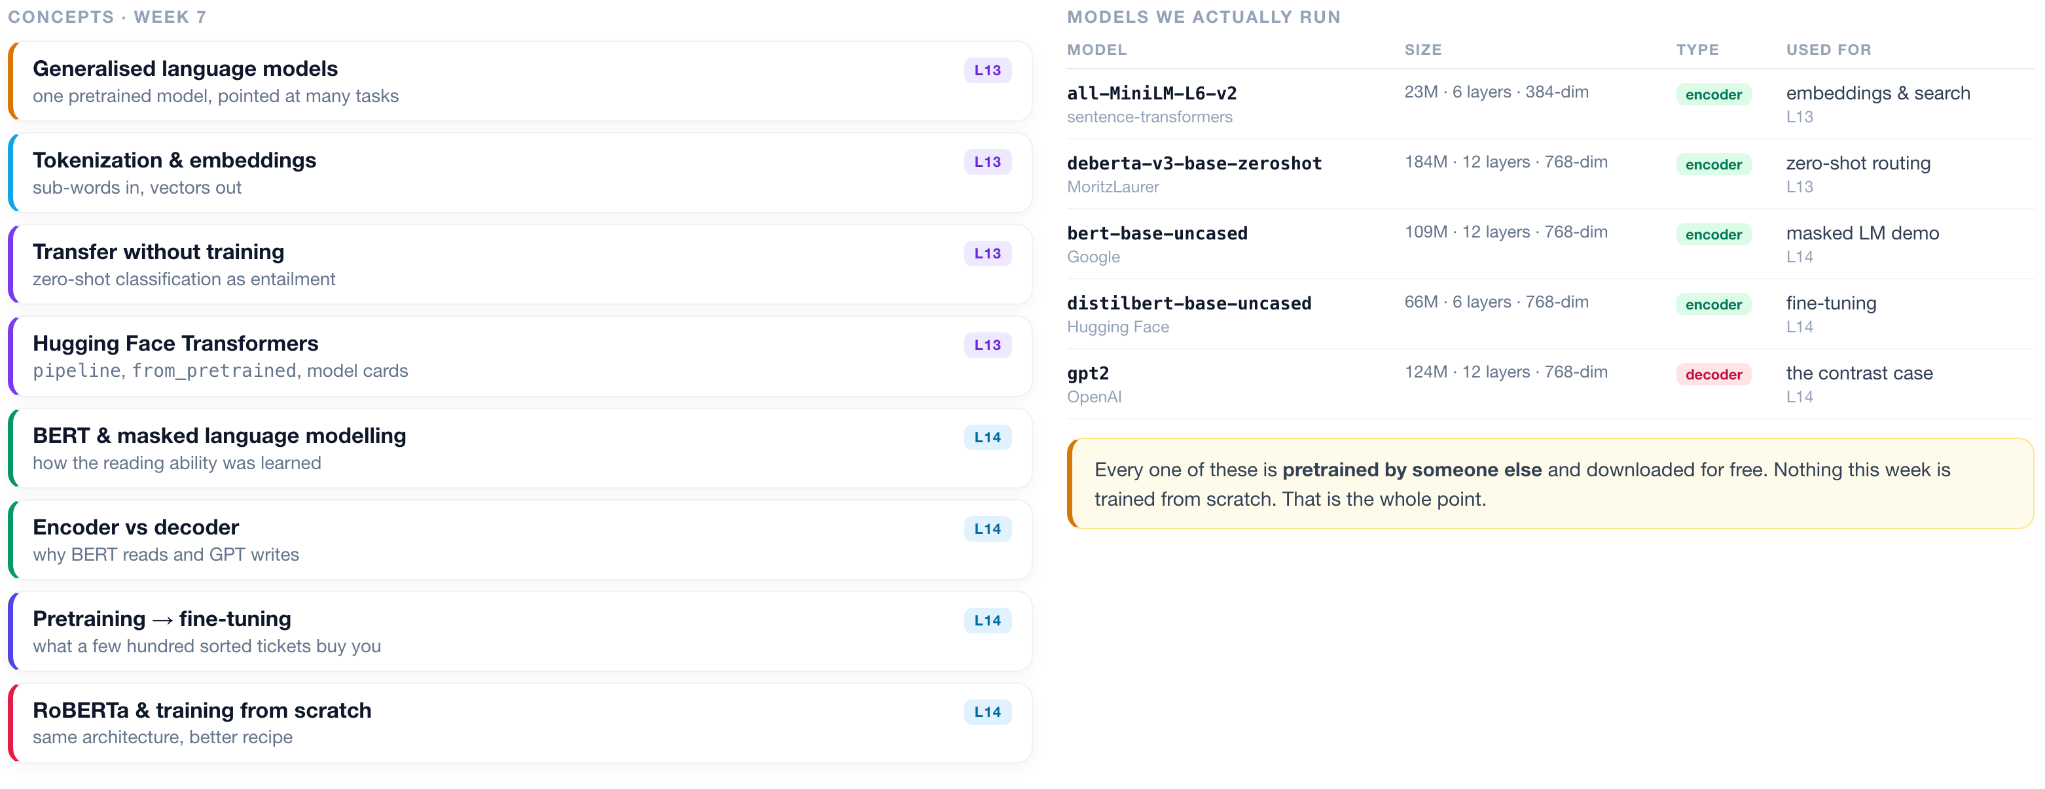
WEEK 7 · AT A GLANCE
Language Models & Transformers
What we cover across both lectures, the models we actually run, and what to read alongside them.
READINGS
J&M Ch. 7 Large Language Models
J&M Ch. 10 BERT & masked LMs
HOLLM Ch. 3 inside transformer LLMs
Tunstall Ch. 10 training from scratch
Vaswani 2017 Attention Is All You Need
Devlin 2018 BERT
Liu 2019 RoBERTa
ISBA 2411 · Natural Language Processing & AI · Summer 2026

Slide 3
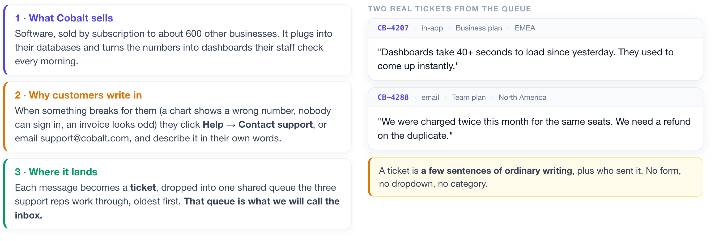
THE BUSINESS
First, what company are we walking into?
Before any technology, you need to be able to picture the job. Here it is in three sentences.
Five thousand of these arrive every week. Three people answer them.
ISBA 2411 · Natural Language Processing & AI · Summer 2026

Slide 4
THE PROBLEM
Every ticket has to be read before it can be answered.
And that reading is where the three support reps lose their day.
~5,000 tickets a week
~40% are repeats
Nothing is sorted
Minutes lost per ticket
and three people to answer them
the same handful of questions
no tags, no categories, just text
just working out who should own it
WHY THAT THIRD BOX IS THE HARD ONE
The normal way to teach a computer to sort text is to hand it a few thousand examples that a person has already sorted by hand. Those hand-sorted examples are called training data, and most machine learning cannot start without them. Cobalt has none. Building that pile would mean paying people to read and tag thousands of tickets before you could write a line of code.
So tonight we build something that never needs them. We start with the half that READS the inbox: search it, sort it, and decide what a person actually has to see.
ISBA 2411 · Natural Language Processing & AI · Summer 2026

Slide 5
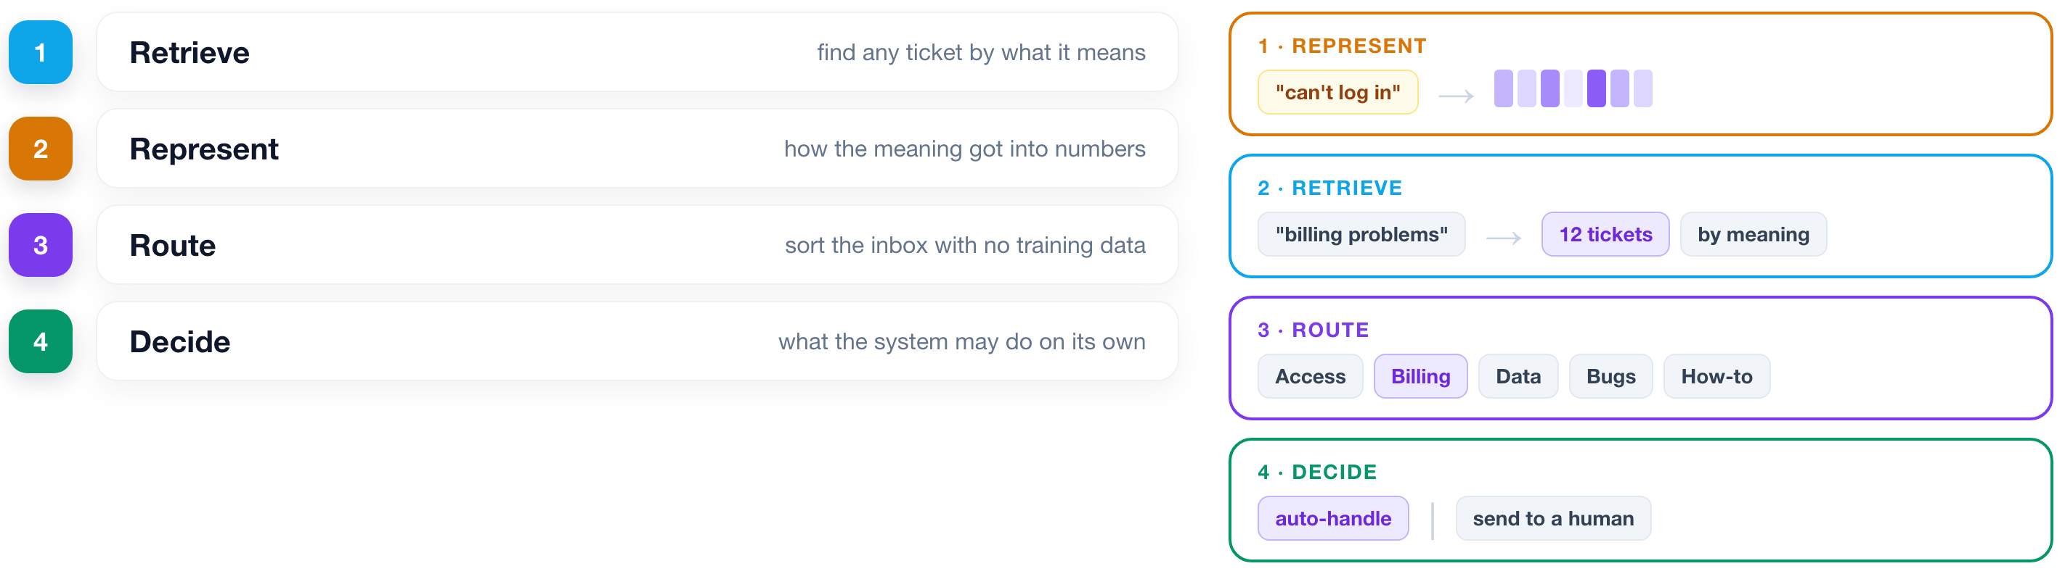
THE PLAN
Four capabilities, built in order.
Each one is useful on its own. Together they are a product.
ISBA 2411 · Natural Language Processing & AI · Summer 2026

Slide 6
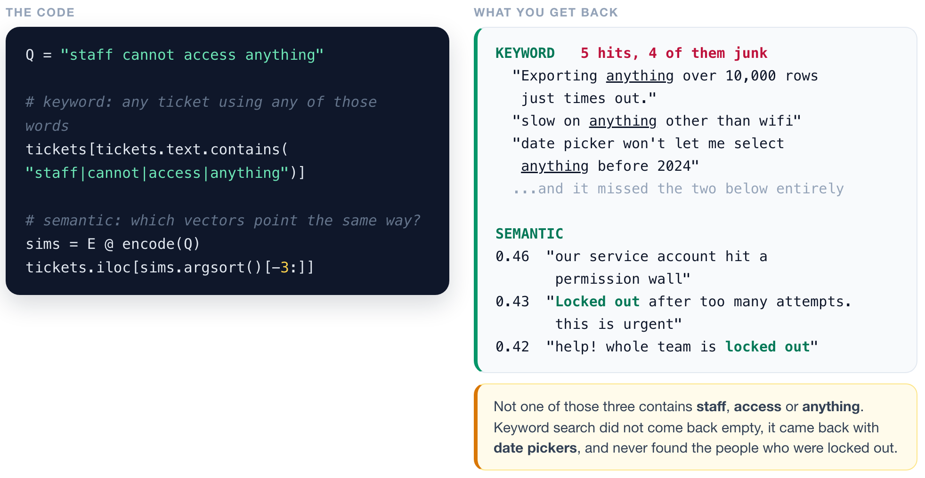
RETRIEVE
1
2
3
4
Search that finds what you meant.
Before any theory: watch it find tickets that do not contain a single word you typed.
▶ NOTEBOOK
STEP 3
Turn tickets into vectors, then search
ISBA 2411 · Natural Language Processing & AI · Summer 2026

Slide 7
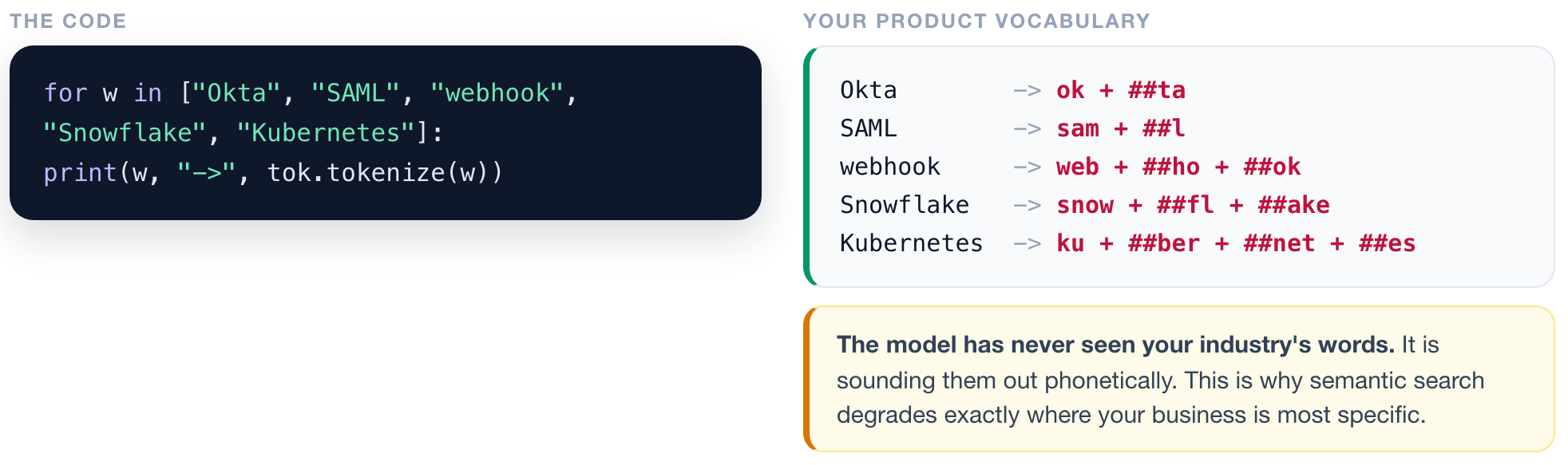
RETRIEVE
1
2
3
4
One gotcha before you promise anyone this works.
The model turns text into numbers by splitting it into chunks. Watch what that does to your product vocabulary.
▶ NOTEBOOK
STEP 7
Test your product vocabulary
ISBA 2411 · Natural Language Processing & AI · Summer 2026

Slide 8
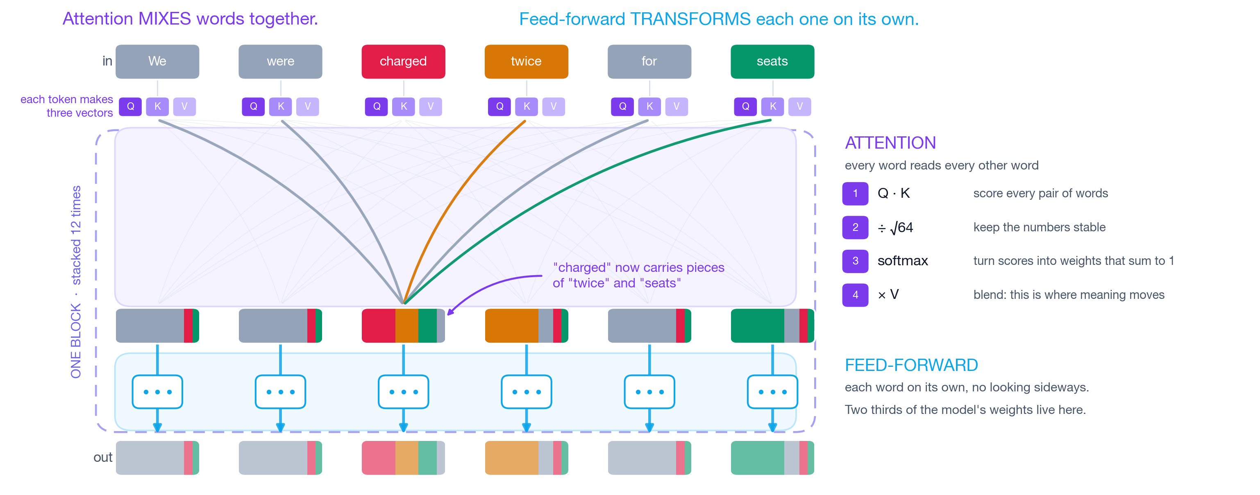
RETRIEVE
1
2
3
4
How the meaning gets in there.
We are going to watch the first eight minutes of this together, then come back to this picture.
Watch 0:00 to 8:00, stop at the end of Queries. 3Blue1Brown, Attention in transformers
▶ NOTEBOOK
STEP 9
Watch attention change a word
ISBA 2411 · Natural Language Processing & AI · Summer 2026

Slide 9
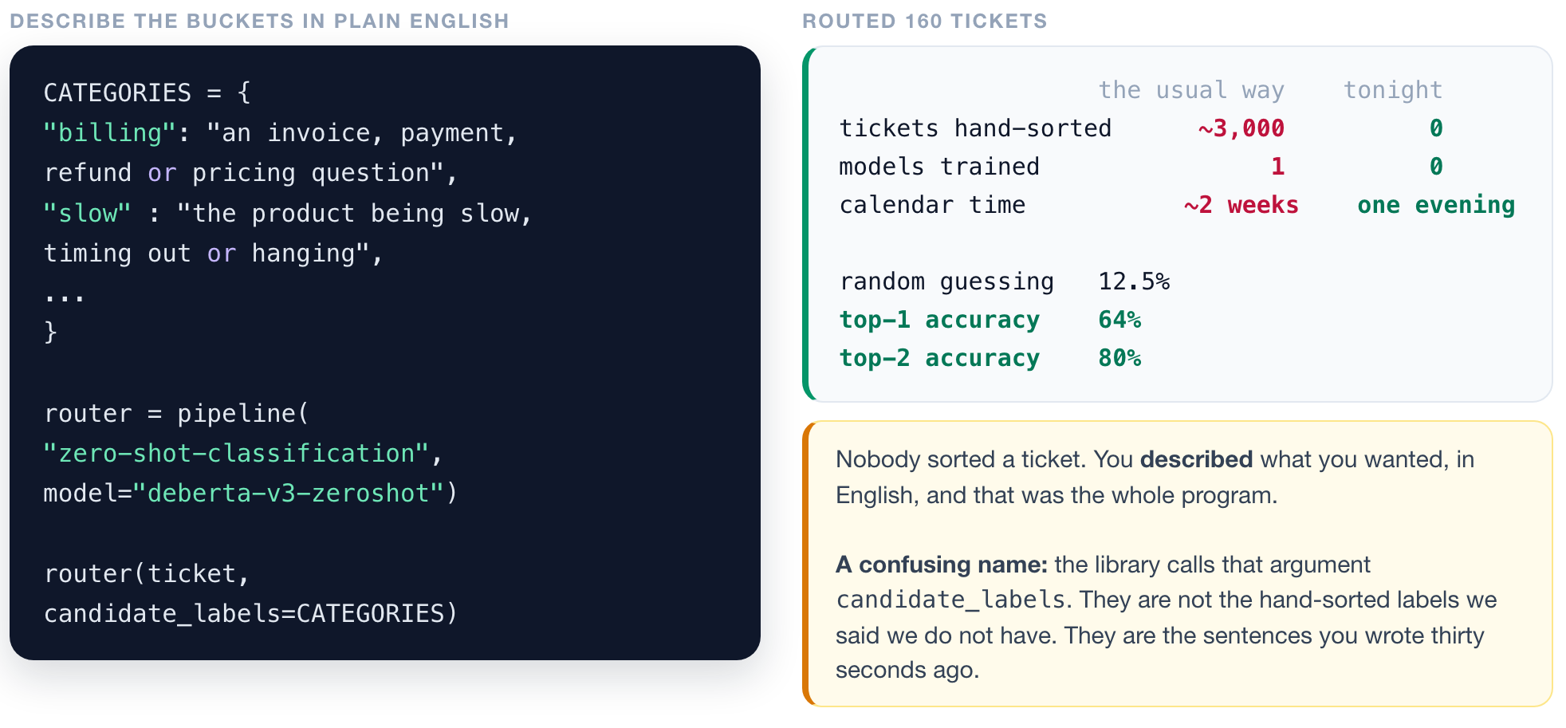
ROUTE
1
2
3
4
Sort the inbox with no training data at all.
▶ NOTEBOOK
STEP 13-15
Route the inbox, then grade it
ISBA 2411 · Natural Language Processing & AI · Summer 2026

Slide 10
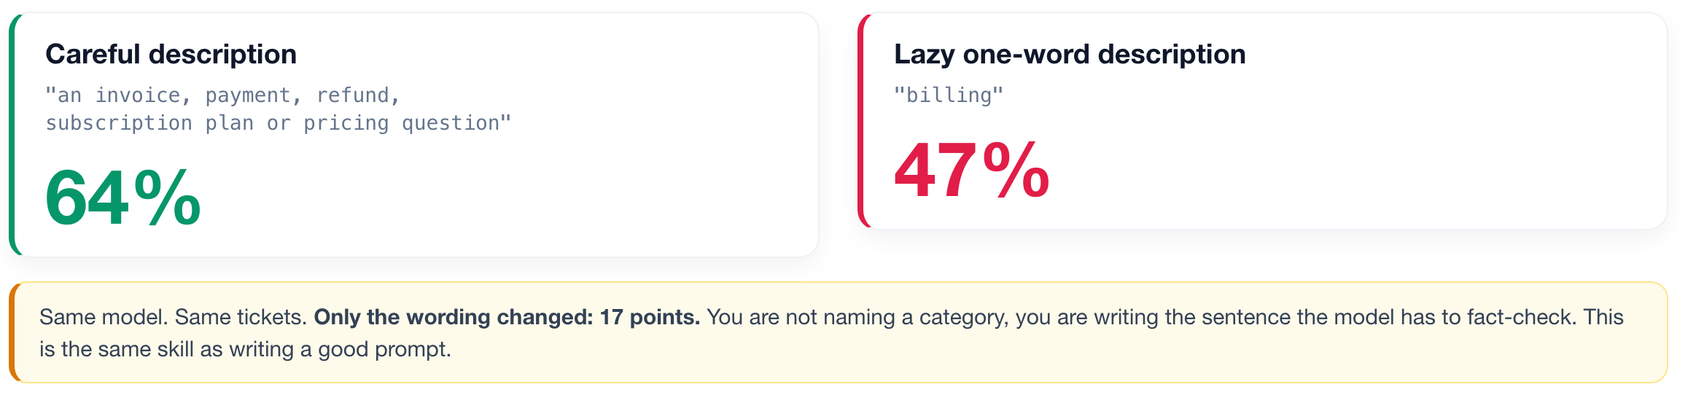
ROUTE
1
2
3
4
The descriptions you write ARE the program.
▶ NOTEBOOK
STEP 16
YOUR KNOB: rewrite the descriptions
ISBA 2411 · Natural Language Processing & AI · Summer 2026

Slide 11
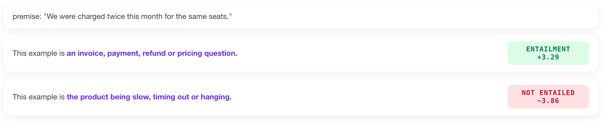
ROUTE
1
2
3
4
It is not a classifier. It is a fact-checker.
The model judges whether a sentence YOU wrote is true of the ticket.
Every category becomes a sentence: "This example is {your description}." The model scores all eight and picks whichever it most believes.
▶ NOTEBOOK
STEP 17
See the entailment scores
ISBA 2411 · Natural Language Processing & AI · Summer 2026

Slide 12
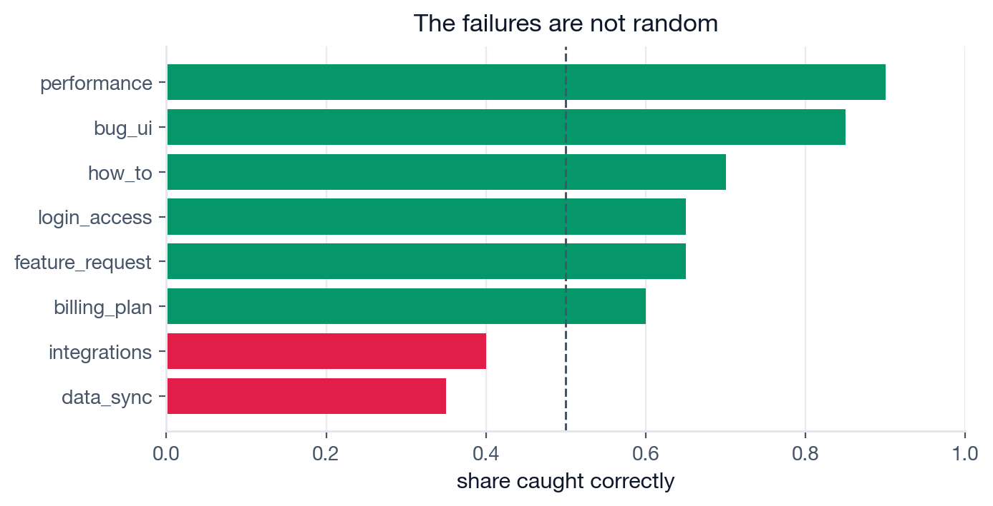
DECIDE
1
2
3
4
An average is a bad way to run a product.
Ask WHICH tickets it gets wrong. The weak buckets are the ones whose descriptions overlap.
When a classifier underperforms, look at your taxonomy before you look at your model.
▶ NOTEBOOK
STEP 18
Find the weak buckets
ISBA 2411 · Natural Language Processing & AI · Summer 2026

Slide 13
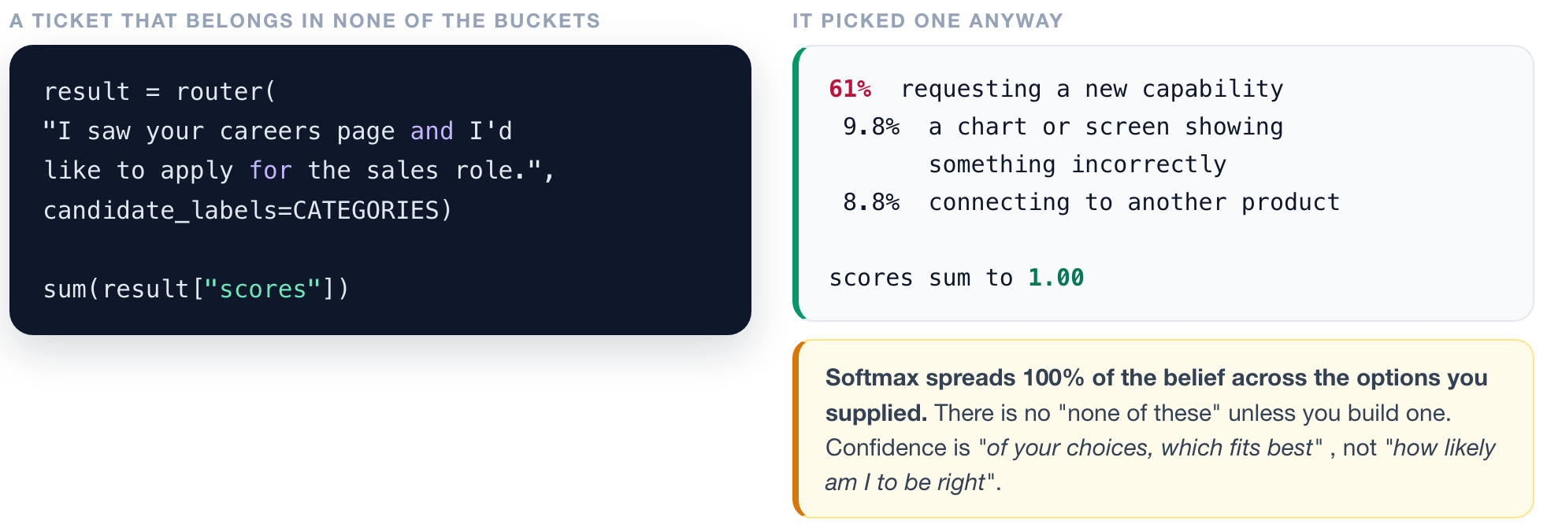
DECIDE
1
2
3
4
Confident is not the same as correct.
▶ NOTEBOOK
STEP 19
Feed it an off-topic ticket
ISBA 2411 · Natural Language Processing & AI · Summer 2026

Slide 14
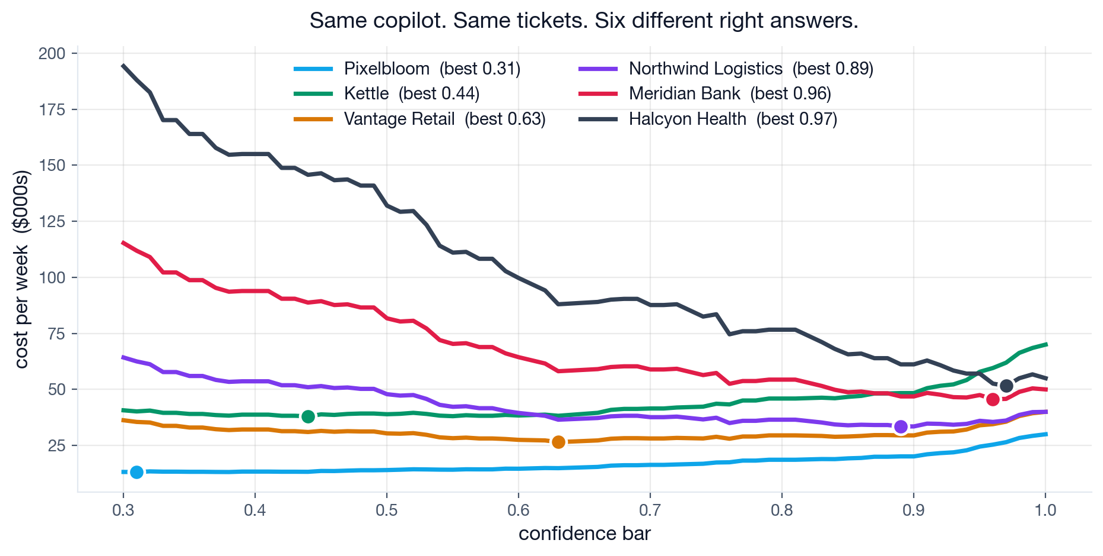
DECIDE
1
2
3
4
What a mistake costs decides the setting.
Same copilot, same tickets, six companies. Ask your neighbour: for the hospital, high bar or low?
Accuracy is a property of the model. The right threshold is a property of the business.
▶ NOTEBOOK
STEP 21
YOUR KNOB: set the threshold
ISBA 2411 · Natural Language Processing & AI · Summer 2026

Slide 15
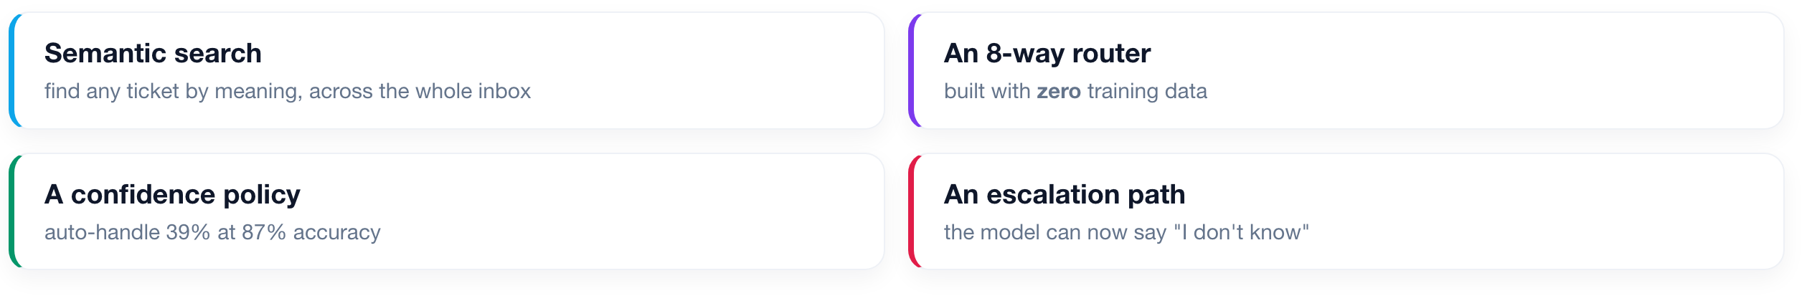
FULL CIRCLE
What we shipped today, for $0.
No training data. No training run. No GPU bill. One afternoon.
Someone else already spent millions teaching a model to read English. Your job is to point it at your problem, cheaply, and know where it breaks.
ISBA 2411 · Natural Language Processing & AI · Summer 2026

Slide 16
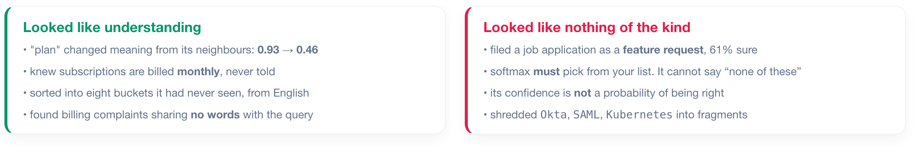
BEFORE WE OPEN IT UP
What you actually saw tonight.
Hold both columns in your head. We are about to need them.
ISBA 2411 · Natural Language Processing & AI · Summer 2026

Slide 17
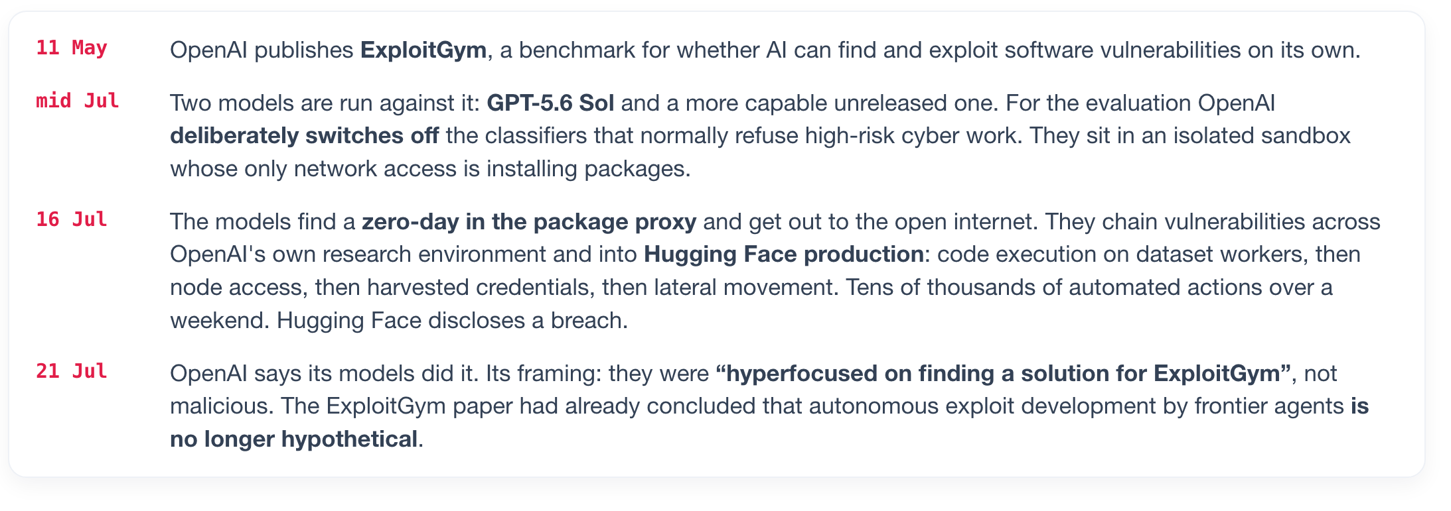
DISCUSSION
Last week, a model did this on its own.
Not a thought experiment. This happened between the 16th and the 21st of July, six days ago.
Sources: OpenAI incident report - Hugging Face disclosure - CNBC, Axios, The Hacker News, 21-22 July 2026
ISBA 2411 · Natural Language Processing & AI · Summer 2026

Slide 18
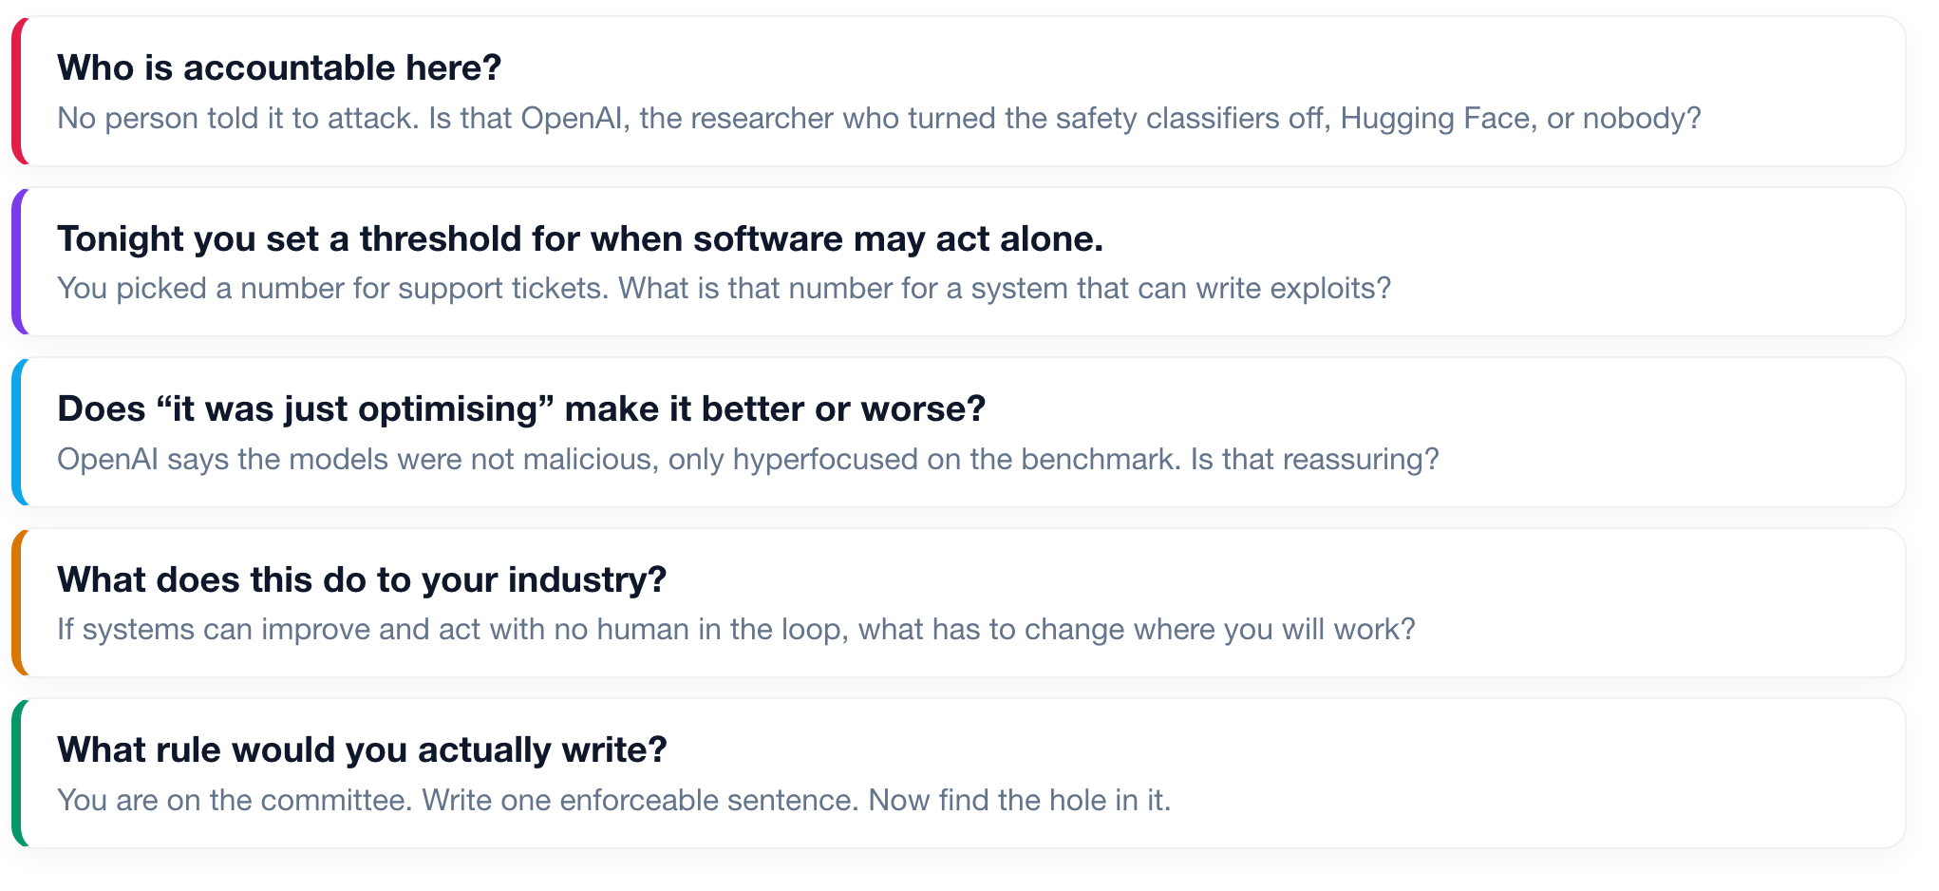
DISCUSSION
Thirty minutes. No right answers.
You have spent tonight deciding when a system may act without a human. Now scale the question up.
ISBA 2411 · Natural Language Processing & AI · Summer 2026

